Slide 1

Driver(s) of Purchase
Driver Model Dataset

Slide 2

AIM AND OBJECTIVE
To determine what drives purchase

Slide 3

Data Description
Dependent Variable
Likelihood to Buy (scale of 1-10)
Independent Variables
Age
Income
Brand Imagery 1 – Brand Imagery 10 (scale of 1-5)

Slide 4


Execution Plan
Data Manipulation and Transformation
Recoding of the Dependent Variable ( Likelihood to Buy)
Transformation of the Independent Variables ( Age, Income , Brand Imagery 1 – Brand Imagery 10)
Correlation I
Data Visualization ( Bar-charts, Pie-Charts, Box-Plots etc)
Data Analysis 1
Logistic Regression, Random Forest, KNeighbors, SVC and Decision Tree Algorithm)
Findings and comments
What next?
Correlation Analysis II
Data Analysis II
Logistic Regression, Random Forest, KNeighbors, SVC and Decision Tree Algorithm)
Findings and comments
Conclusion

Slide 5
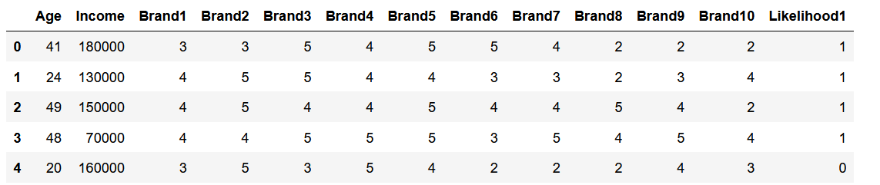
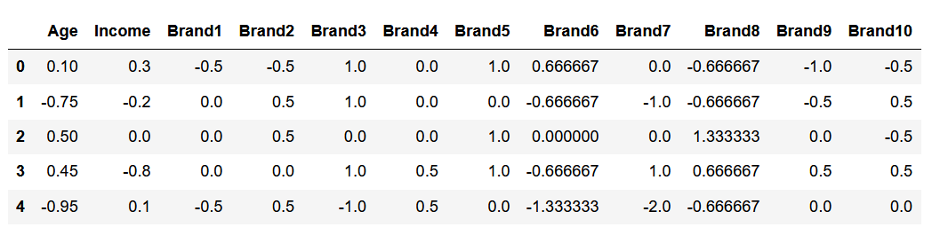
Data Manipulation and transformation
The dependent variable is on a scale of 1-10 . It needs to be recoded with a dummy variable of
1 for “Will Purchase” (from 5-10) and
0 for “Will not Purchase” (from 0-4)
Below is a glimpse of it:
Execution Plan
There is a need to transform the data because the dependent variables are not of the same scale. Looking at the Driver Model Dataset, “Age” and “Income” are on different scale and if transformation is not done then during analysis of the data the algorithm will favor the independent variable with higher values so to avoid this we need to transform the independent variables from the dataset and below is a snippet of the transformed data of the independent variables.

Slide 6
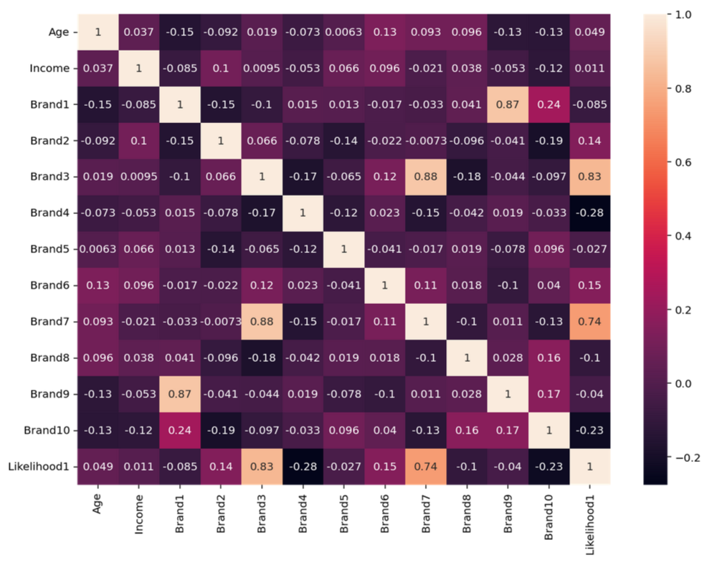
Correlation Analysis 1
A correlation analysis was ran to see if the independent variable are highly correlated with each other and this is because in most multivariate data there is an underlying data problem, which is multi-collinearity and this is when the predictors or independent variables are highly correlated with each other. In a nutshell, respondents liking a brand tend to give it high ratings on all attributes, while respondents disliking a brand tend to give it low marks across the board. These variables with high ratings on all attributes tend to be highly correlated.
Comments:
Aside from the fact that Brand Imagery 1 and Brand Imagery 9 are highly positively correlated with Likelihood to buy it can also be seen that;
Brand Imagery 1 and Brand Imagery 9 are highly correlated with each other
Brand Imagery 3 and Brand Imagery 7 are also highly correlated with each other
there is a problem of multi-collinearity.

Slide 7
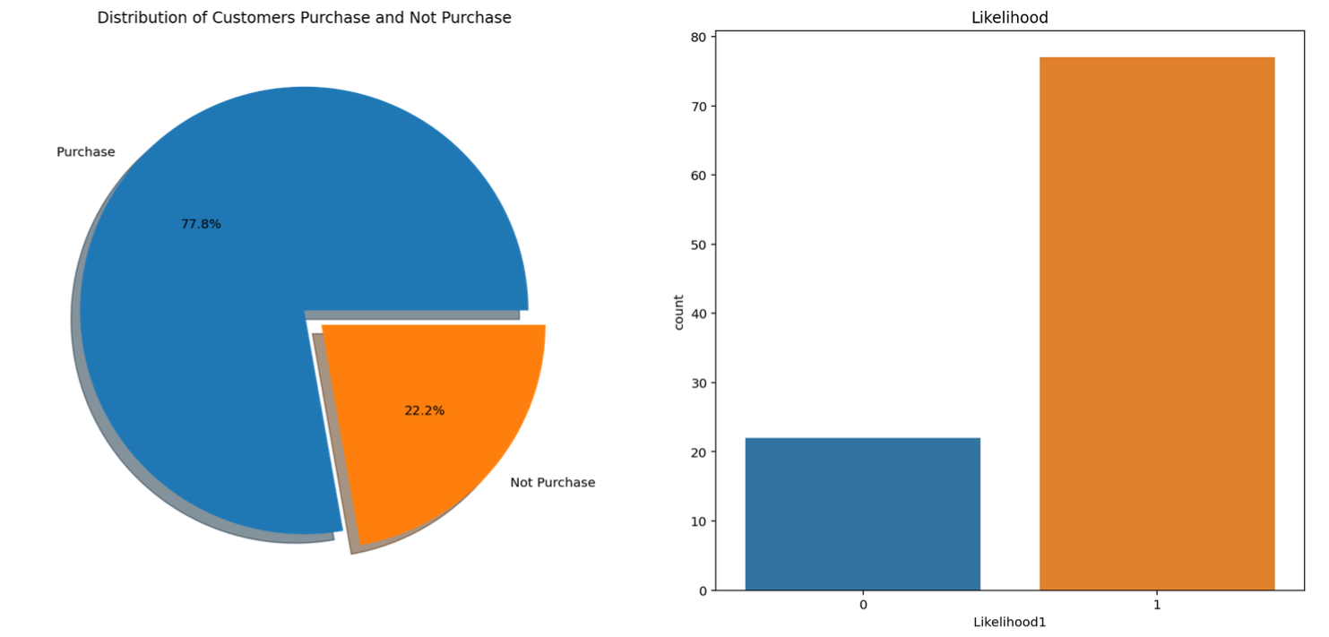
Data visualization
77.8%
22.2%
the customers will make a purchase
the customers will not make a purchase

Slide 8
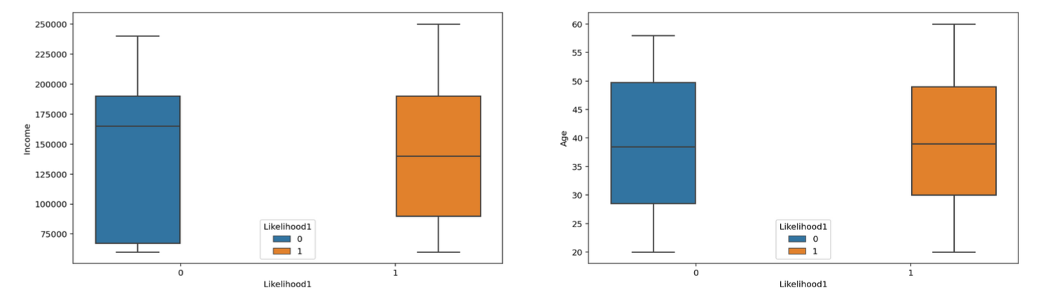
163,000
133,000
37
38
the median income of those that will not make a purchase.
the median income of those that will make purchase
the median age of those that will make a purchase
the median age of those that will not make a purchase

Slide 9
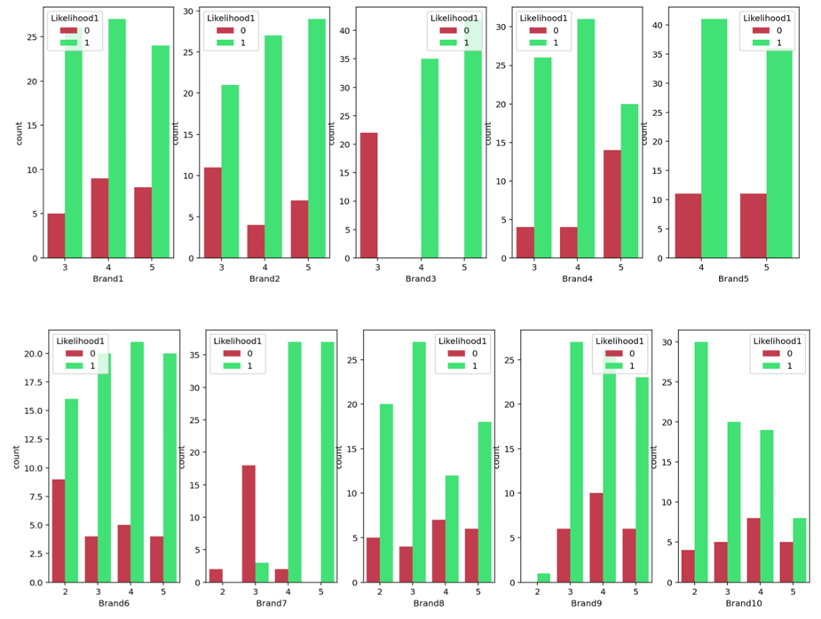
This shows that;
irrespective of whether the Brand Imagery linkert scale score is high or low the likelihood to buy is high.

Slide 10
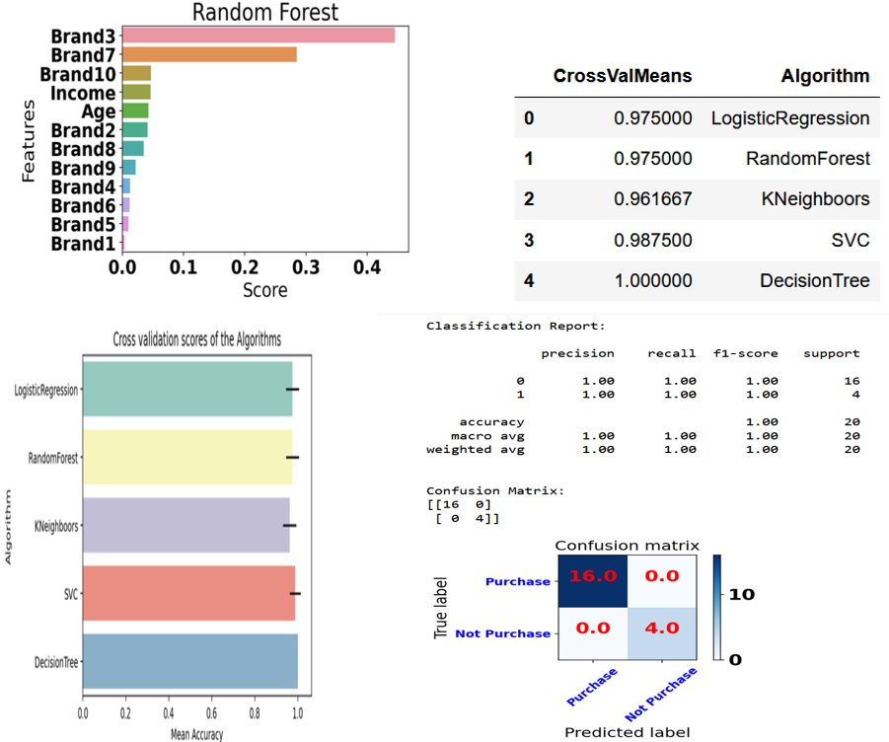
Data Analysis 1

Slide 11

Findings and Comments
After the dependent variables are coded and the independent variables are transformed so they can be the same scale, an analysis was carried out using the Random Forest Algorithm and the result reveals that;
Brand 3 and 7 drives purchase more than the rest of the brands
A test of accuracy was carried out using the Logistic Regression, Random Forest Algorithm, KNeighbors, SVC and Decision Tree Algorithm. These algorithms are used to compare the random Forest algorithm because they one of the most powerful algorithms when dealing with classification. The test of model accuracy shows that;
Decision Tree is 100% accurate and
Random Forest is 97.5%.
From the confusion matrix, the 0’s shows that there is no mismatch and the algorithm predicted that there would;
be a purchase 16 times and there was actually a purchase 16 times.
won’t be a purchase 4 times and there was actually no purchase 4 times.

Slide 12

What NEXT?
We can improve the accuracy of the model by removing the problem of multi-collinearity. From the correlation anlaysis , it has already been established that Brand Imagery 3 and Brand Imagery 7; Brand Imagery 9 and Brand Imagery 1 are highly correlated. In statistics when we have two highly correlated variables we remove one of them.
Also from the Random Forest Analysis, Brand Imagery 3 drives purchase more than Brand Imagery 7 and so is Brand Imagery 9 more than Brand Imagery 1 so Brand Imagery 7 and 1 was remove and the algorithm was ran again to observe their effects.

Slide 13
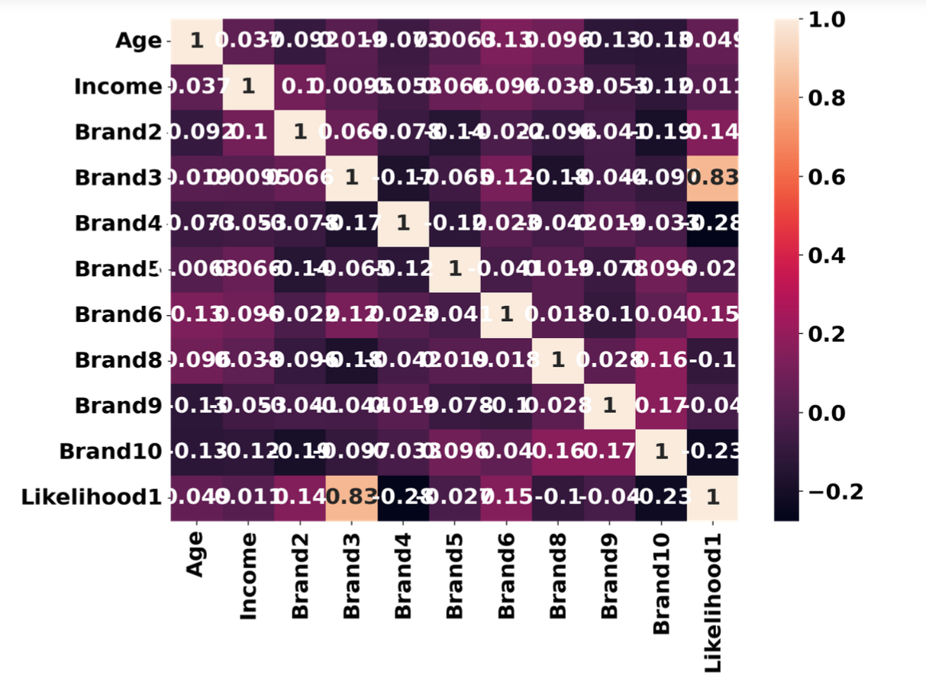
cOrrelation analysis of the transformed and coded dataset without Brand Imagery 1 and 7
COMMENTS
Now without Brand Imagery 1 and 7, it can be seen;
that the independent variables are not highly correlated with each other.
One fact still remains that Brand Imagery 3 is a very strong driver of purchase because of how highly correlated it is with the likelihood to buy.
Brand 3 is a very big contender as the best attribute that drives purchase

Slide 14
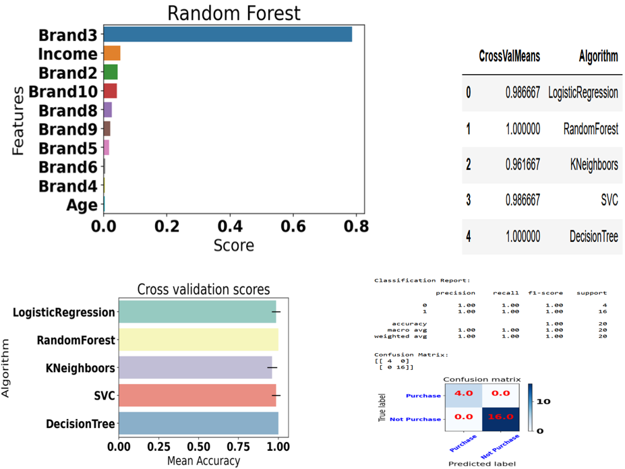
Data Analysis ii

Slide 15
Findings and ComMents
The above test of model accuracy shows that;
Decision Tree is 100% accurate and
Random Forest is 100% accurate
Note
Random Forest was not 100% accurate when the issue of multi-collinearity has not been addressed i.e when we still have brand Imagery 1 and 7 in the model.
From the confusion matrix, the 0’s shows that there is no mismatch and the algorithm predicted that there would;
be a purchase 16 times and there was actually a purchase 16 times.
won’t be a purchase 4 times and there was actually no purchase 4 times.

Slide 16
Conclusion
It can be seen that brand Imagery 3 is still the major driver of purchase when Brand Imagery 1 and 7 are removed from the algorithm. Since this is the case the energy and financial resources needed for Brand Imagery 7 and 1 should be channeled to optimize brand Imagery 3, Income, Brand Imagery 2, 10, 8, 9 and 5. As for Brand Imagery 6, 4 and Age, they can be disregarded as a driver of purchase while the resources used for them should be used for brand Imagery 3, Income, Brand Imagery 2, 10, 8, 9 and 5
$$1^{st}$$
𝟏^𝒔𝒕
Brand Imagery 3
$$2^{nd}$$
𝟐^𝒏𝒅
Income
$$3^{rd}$$
𝟑^𝒓𝒅
$$4^{th}$$
𝟒^𝒕𝒉
Brand Imagery 2
Brand Imagery 10
Brand Imagery 8
Brand Imagery 9
Brand Imagery 5
$$6^{th}$$
𝟔^𝒕𝒉
$$7^{th}$$
𝟕^𝒕𝒉
$$5^{th}$$
𝟓^𝒕𝒉
From the correlation analysis and the analysis with random forest in data analysis I to the correlation analysis and the analysis with random forest in data analysis II, Brand Imagery 3 has been consistent as the leader of the park so it is not surprising to see it as the best driver of purchase as was predicted

Slide 17
Thank you
Uchechukwu Anthony Ogwurumba
+1 470 621 2076
uogwurumba1@student.gsu.edu
Data Analyst

